Slide 1
YOUTUBE SONGS ANALYSIS DASHBOARD
MENTORNESS
By Mohamed Skander Gharbi

Slide 2

Introduction
Data Description
Project Objectives
Dashboard
Conclusion

Slide 3



Introduction
our internship project, where we aim to conduct an in-depth analysis of YouTube songs data using Power BI. This project leverages a rich dataset to uncover insights into the performance, popularity, and user engagement of YouTube song content.
Project Goals
The primary objective is to harness the power of Power BI to create insightful visualizations and reports. These tools will provide a deeper understanding of various aspects of YouTube songs, such as:
Performance metrics
Popularity trends over time
User engagement patterns

Slide 4
Dataset Description:
Our dataset encompasses several key attributes, including:
1. video_id: Unique identifier for each YouTube video.
2. channelTitle: Title of the YouTube channel publishing the song.
3. title: Title of the YouTube song video.
4. description: Description provided for the YouTube song video.
5. tags: Tags associated with the YouTube song video.
6. publishedAt: Date and time when the YouTube song video was published.
7. viewCount: Number of views received by the YouTube song video.
8. likeCount: Number of likes received by the YouTube song video.
9. favoriteCount: Number of times the YouTube song video has been marked as a favorite.
10. commentCount: Number of comments posted on the YouTube song video.
11. duration: Duration of the YouTube song video.
12. definition: Video definition or quality (e.g., HD, SD).
13. caption: Availability of captions for the YouTube song video.

Slide 5
Project Objectives
Data Cleaning
Exploring Data Analysis
Content and Channel Analysis
Temporal trends
User Engagement Insights

Slide 6
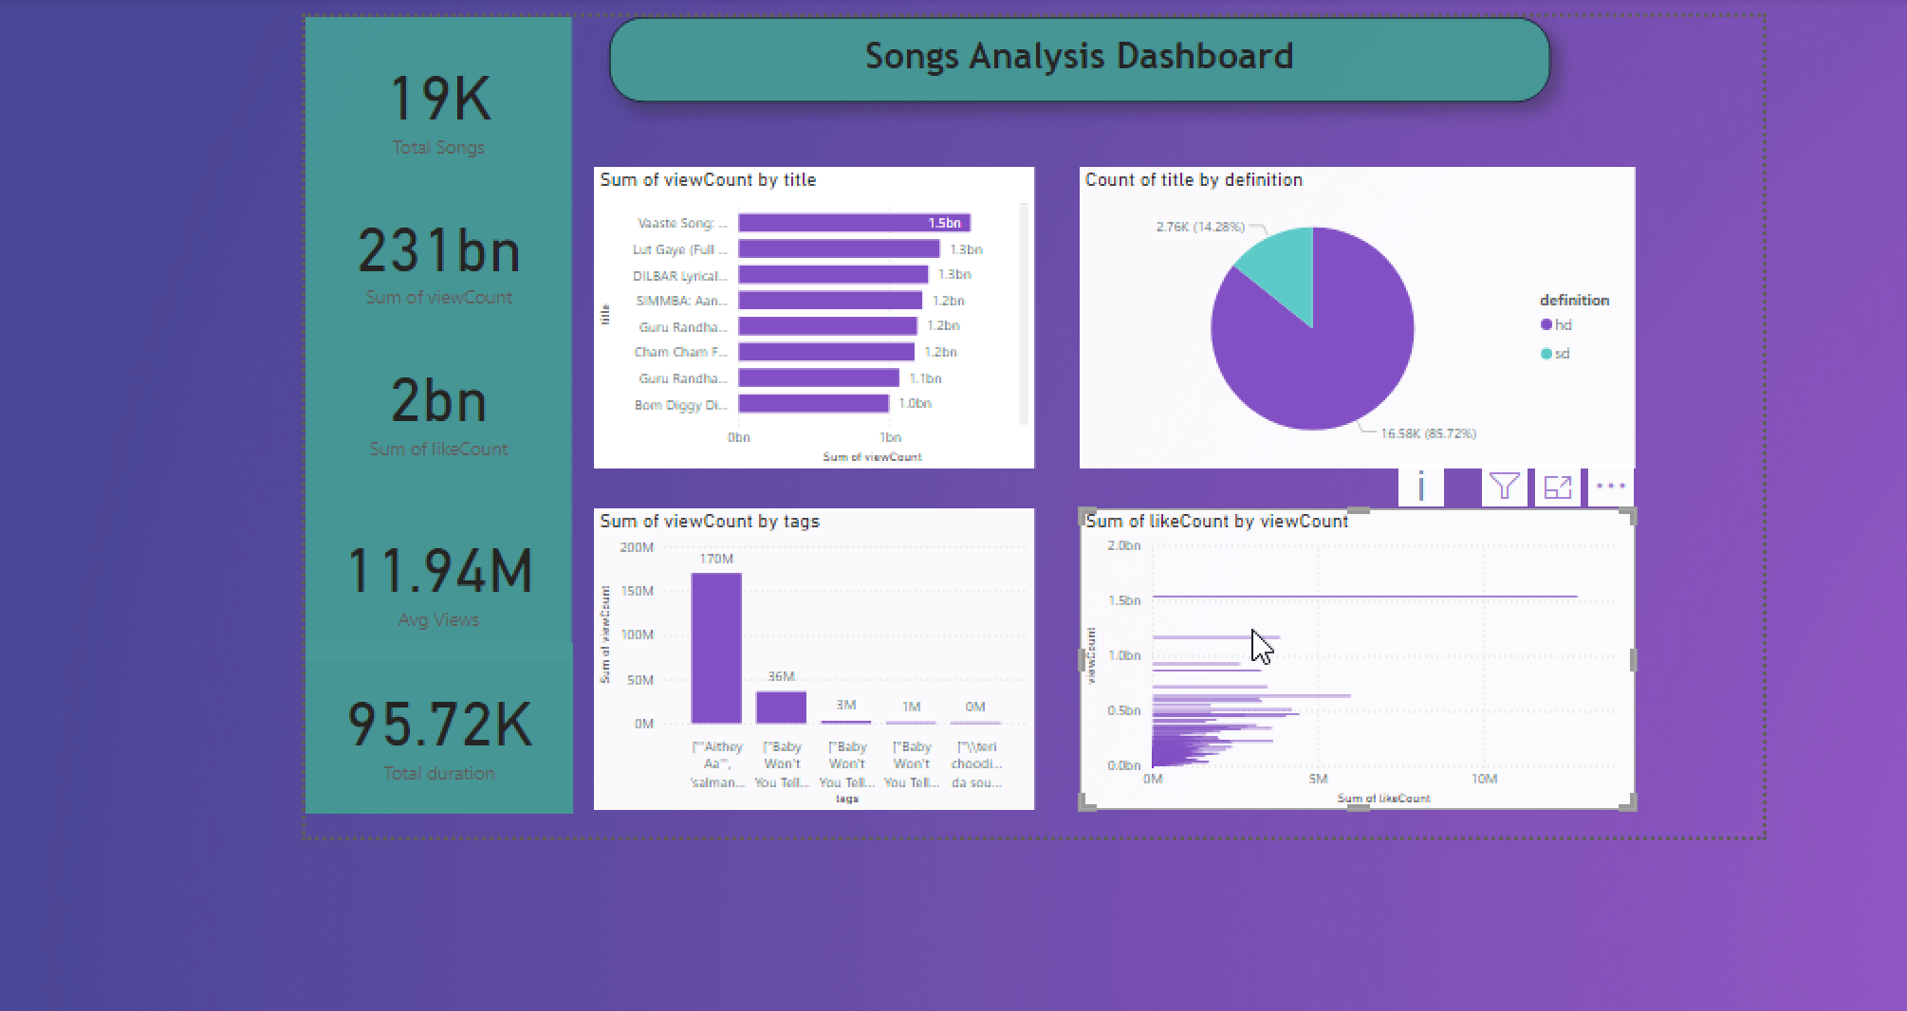

Slide 7

Conclusion
The "Songs Analysis Dashboard" project offers critical insights into the performance and engagement metrics of popular songs. Key findings include:
Top Performers: "Vaaste Song," "Lut Gaye," and "Dilbar Lyrical" rank among the most viewed and commented songs.
Popular Tags: Tags like "T-Series," "High Rated Gabru," and "Cham Cham" boost viewership.
Engagement Correlation: A strong link between views and likes underscores the importance of engagement metrics.
Top Definiton: "HD”.

Slide 8
Thank you for your attention

